Slide 1



UTA EE Labs
Controlling your Arduino with Bluetooth
IEEE 802.15. 4

Slide 2
PowerPoint and Code
Github.com/EELabMan
Go To Repositories and find Arduino 9 Bluetooth

Slide 3
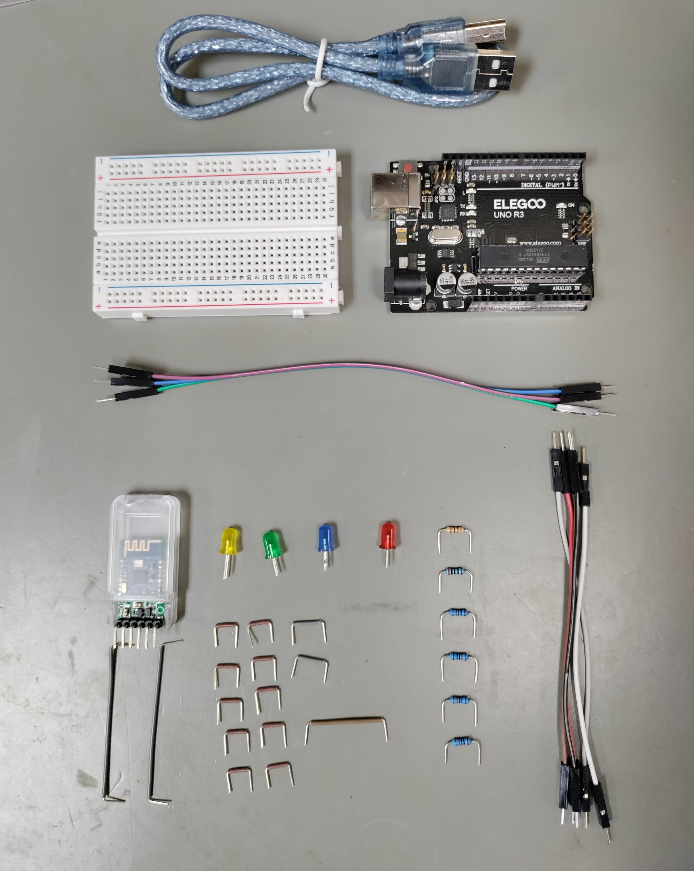
Parts
USB Cable
Breadboard
Uno
3 long M to M
Yellow
Red
Green
Blue
300Ω
HM-18 Bluetooth
200Ω
5 short M to M
2x .5”
4 x
220Ω
10x .4”
1x 1”
2x 2.1”

Slide 4

Why the Name Bluetooth
King Harald “Bluetooth” Gormsson was viewed as a great uniter.
He was called Bluetooth due to a dark blue or gray tooth, possibly from a dead tooth or from eating blueberries. Bluetooth tech seeks to “unite” devices.
Bluetooth symbol is his initials in Nordic Runes.

Slide 5
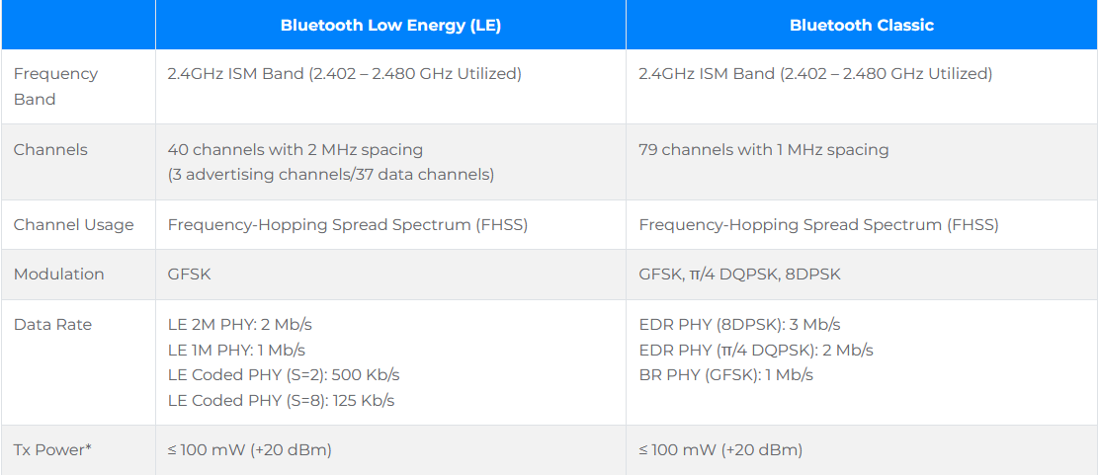
BLE Versus Bluetooth Classic

Slide 6
Frequency Hopping Spread Spectrum : FHSS
How FHSS works in Bluetooth 4 and above
1. The 2.4 GHz band:
Bluetooth operates in the globally available 2.4 GHz Industrial, Scientific, and Medical (ISM) band, which is divided into many 1-MHz-wide channels.
2. Pseudorandom sequence:
Both the transmitting and receiving Bluetooth devices share a unique, pseudorandom sequence that determines the order in which they hop between these channels.
3. Rapid switching:
Devices switch channels at high speed, performing 1,600 hops per second, ensuring that no single channel is used for an extended period.
4. Synchronization:
The devices' shared sequence keeps them synchronized, meaning they both hop to the same channel at the same time.

Slide 7
Frequency Hopping Spread Spectrum : FHSS
Why FHSS is important for Bluetooth?
Interference resistance:
By hopping across many frequencies, Bluetooth avoids prolonged exposure to interference on any single channel.
Coexistence:
FHSS allows Bluetooth to share the 2.4 GHz band with other wireless technologies like Wi-Fi without causing significant disruption to either.
Improved reliability:
Even if a single frequency channel experiences interference, it only affects a small portion of the data transmission, and the connection quickly moves to a different channel.
Security:
If an unauthorized device tries to listen in, it would have to know the specific hopping sequence to follow the transmission, making it difficult to intercept the signal in real-time.

Slide 8
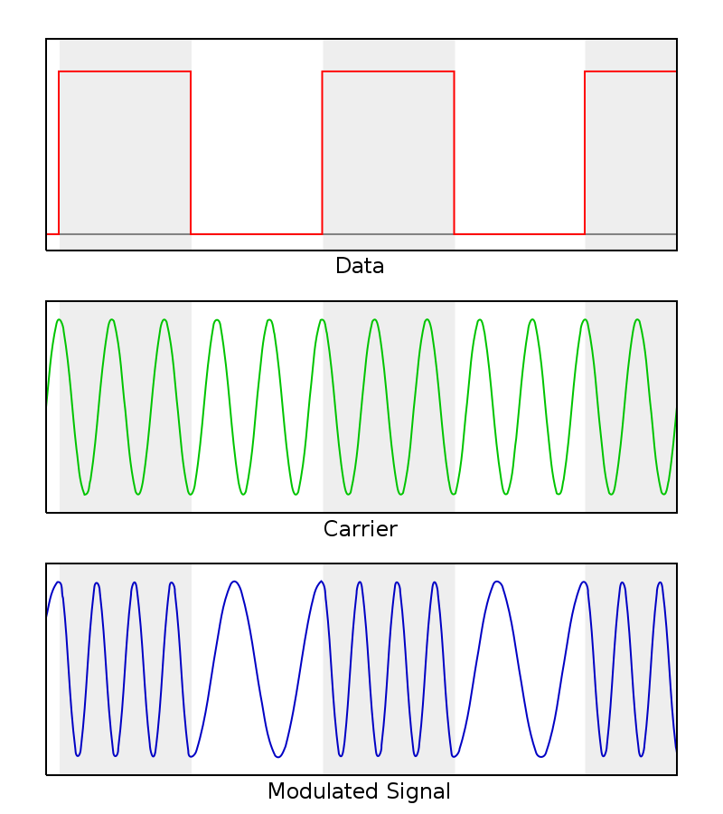
Modulation: Frequency Shift keying
Data
Data
Carrier Frequency
Carrier
Modulated Carrier
Modulated Signal

Slide 9
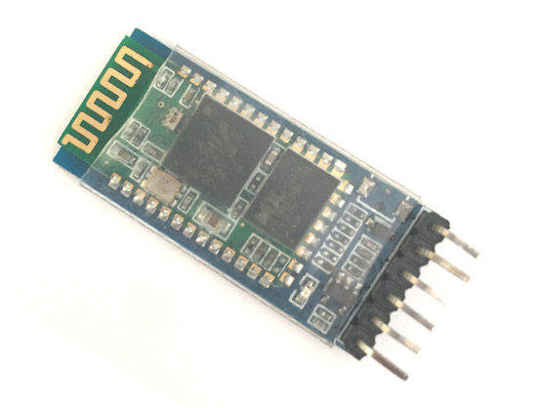
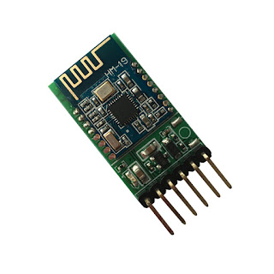
HC-05 & HM-19 Bluetooth module
HC-05
Uses Bluetooth 3.0
iPhone does not support BT 3.0
HM-19
Uses Bluetooth 5 and 4.2
Most modern phones support Bluetooth 4.0 and higher

Slide 10
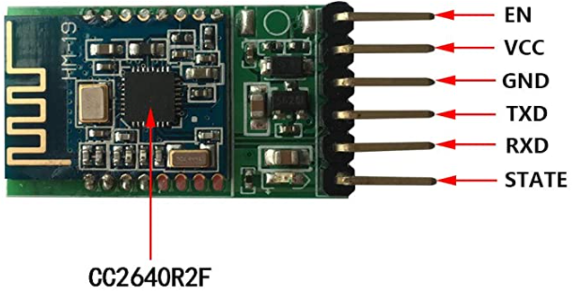
HM-19 Pinout
TI CC2640R2F Bluetooth Chip
Antenna is a trace on the PCB
3.3V Logic to RX Pin. Must use a voltage divider to lower 5V logic from Arduino.

Slide 11
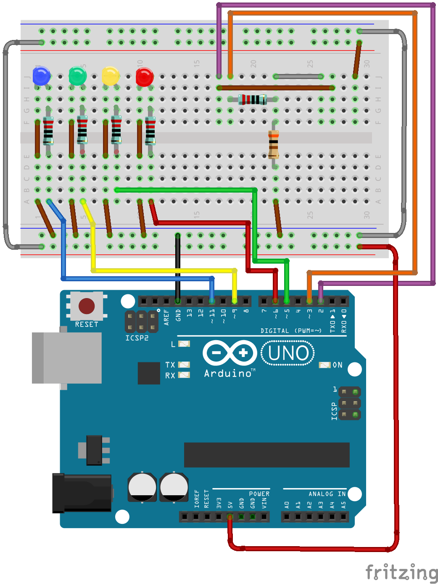
Let’s Create
LED cathode is on the left
Notice the 200 and 300 Ω resistors make a voltage divider because the Arduino has 5V logic, but the HM-19 takes 3.3V logic

Slide 12
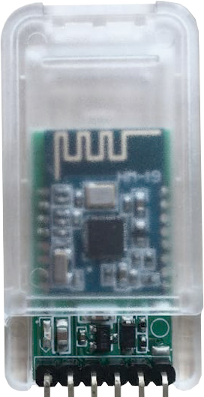
Let’s Create
Insert the HM-19 Module as shown

Slide 13
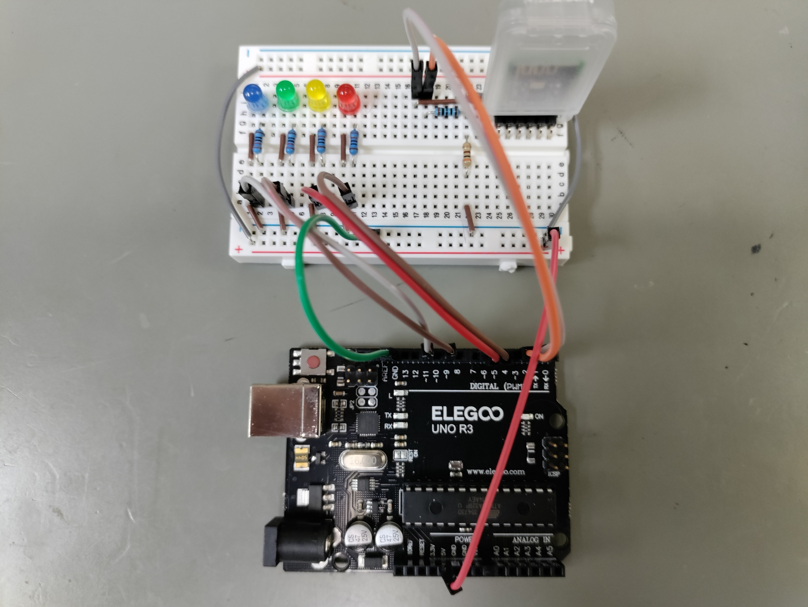
Photo

Slide 14
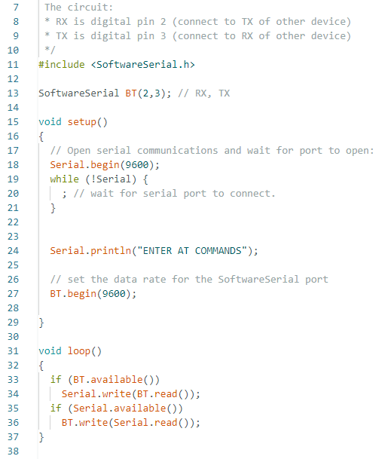
Let’s Code
Open BT_AT_Commands.ino from in the Arduino IDE software and upload to the Arduino
Notice the #include <SoftwareSerial.h> . The Arduino Uno only has one hardware serial port, Pin 0 for RX and Pin 1 for TX.
That serial port is used to program the Uno and for serial communications from the Arduino IDE and the Uno.
To make another serial port to communicate to the Bluetooth module, we can use the software serial include. Notice line 13 names this new serial port to BT and assigns pins 2 and 3 for the communication.
Lines 33 to 34 pass data from the Bluetooth module to the Arduino Uno then to the Arduino Serial monitor.
Lines 35 to 36 pass data from Serial Monitor -> Uno -> Bluetooth module.

Slide 15
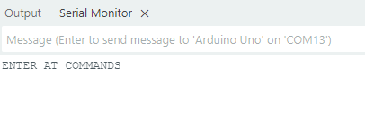
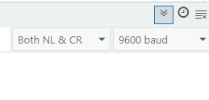
Serial Monitor
Once the Arduino is programmed: Open the serial Monitor.
It should say ENTER AT COMMANDS
If not, Ensure the BAUD rate is set to 9600 and Both NL & CR are selected in the serial monitor
If it is still not working – go back and check your wiring.

Slide 16
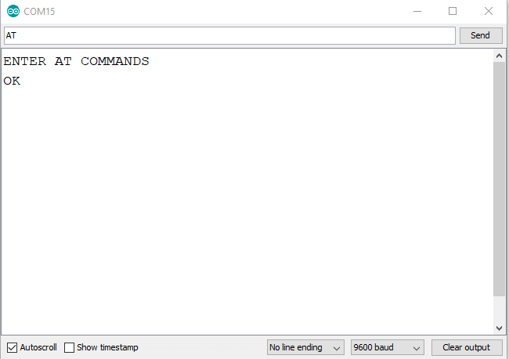
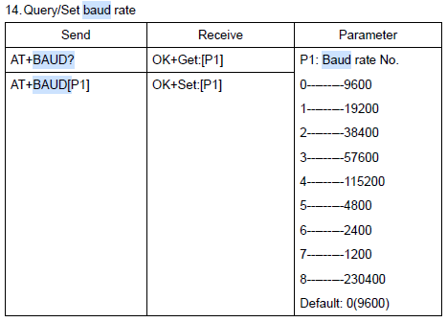
AT COMMANDS for HM-19
Open the serial monitor and enter the following AT Commands
AT : Check the connection. Should return OK AT+NAME? : See default name AT+ADDR? : Returned the device MAC Address AT+VERS? : See firmware version AT+BAUD? : See baudrate Many more on the datasheet.
You might need to change the following to get it to work
No line ending just sends what you put. New line sends an ASCII new line code after what you put Carriage return puts an ASCII carriage return character after what you put.
NL + CR puts both a carriage return and a new line character after what you put.

Slide 17
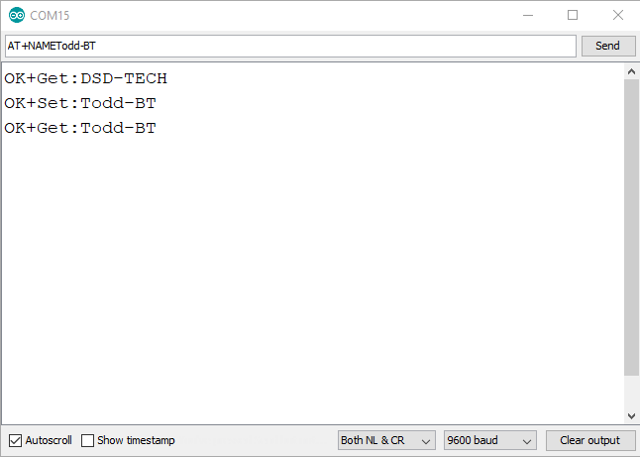
Set a new Name for the HC-19
Type AT+NAMEXXX - XXX is any short name you want.
Should return OK
Type AT+NAME? to confirm new name.
When searching for a Bluetooth signal, this will be the name you see on list.

Slide 18
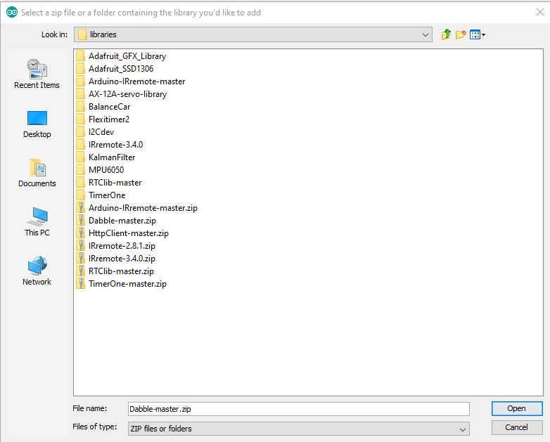
Add the Dabble Library to Arduino
Download the Dabble Arduino Library ZIP file from our GitHub page.
Place it in the Documents\Arduino\libraries folder. Do not unzip the zip file.
In the Arduino IDE go to Sketch -> Included Library -> Add ZIP Library.
Select the Dabble-master.zip file from the Documents\Arduino\libraries folder.

Slide 19
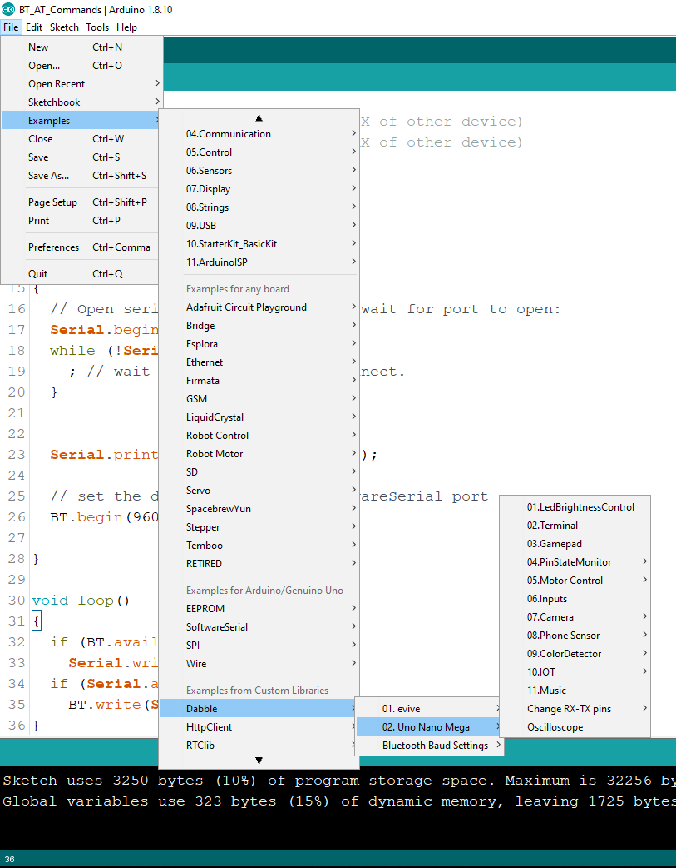
Open the Sketch
File -> Examples -> Dabble -> 02.Uno Nano Mega
Select 01.LedBrightnessControl
Upload to your UNO.

Slide 20
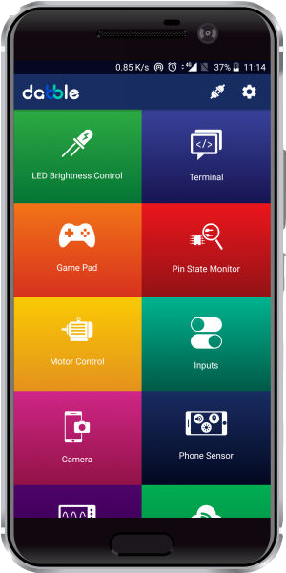


Install Dabble on your smart phone
Dabble is available for the Android user functioning on Android version 5.0.0 and above.
It is compatible with iPhone, iPad, and iPad touch and requires iOS 12.2 and above
Might need to install from the web site.

Slide 21
Open Dabble and connect
Open dabble and select the connection icon
Find your BT device and select it.
It will be a long list but, if you don’t see it, Reboot the Uno.
The next time you connect, it will be listed at the top of the list.

Slide 22
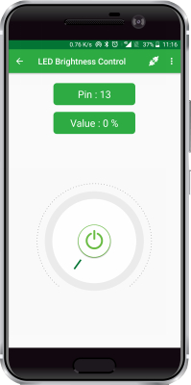
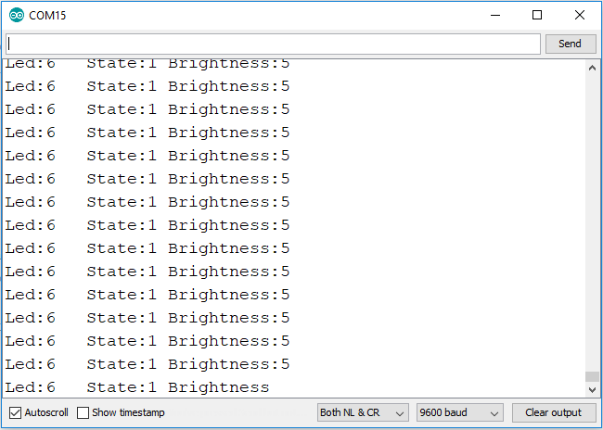
Open the LED Brightness Control
Open the serial monitor in the Arduino IDE
Select pins 5, 6, 9 and 11 on the Dabble app to control the LED’s.

Slide 23
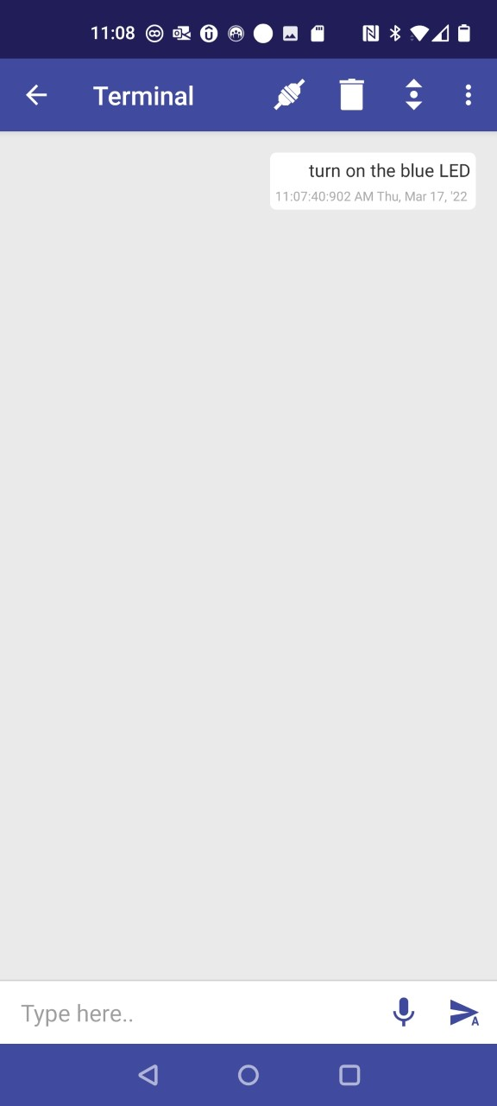
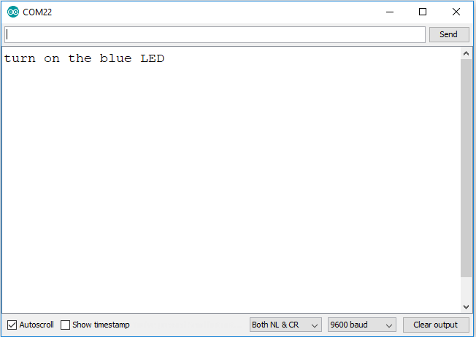
Open the Sketch
Android voice commands:
turn on the blue LED
turn on the green LED
turn on the yellow LED
turn on the red LED
all on
all off
Disconnect from Dabble on your phone first.
Upload Terminal_Voice.ino
Open Dabble and connect to BT.
Open terminal
Open the serial Monitor in the Arduino IDE
Press the microphone on Dabble and say “turn on the blue LED”
Depending on your voice assistant, you may need to change the Arduino code.
Try “all on” and “all off”
If voice to text doesn’t work : Type the message in the into Dabble
Apple voice commands:
You will need to change the code and reupload. First letter will be capitalized.
Turn on the blue LED
Turn on the green LED
Turn on the yellow LED
Turn on the red LED
All on
All off

Slide 24
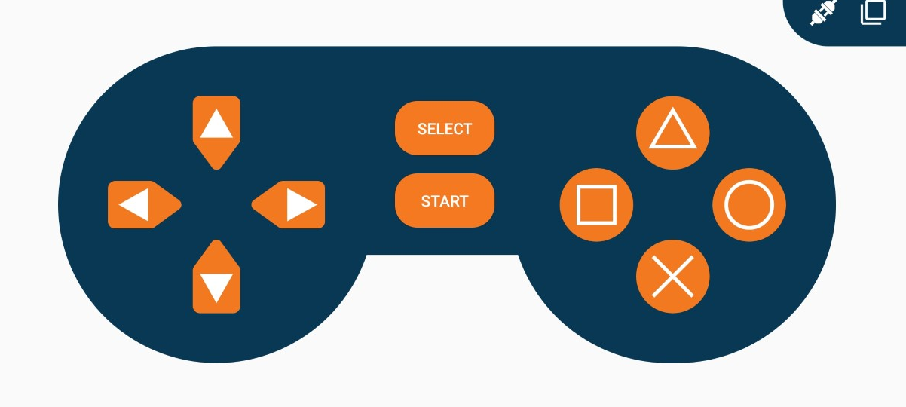
Dabble GamePad
Upload Gamepad_LED.ino
Open Dabble and connect again.
Examine the code while pressing the buttons.
Check the BAUD Rate!

Slide 25
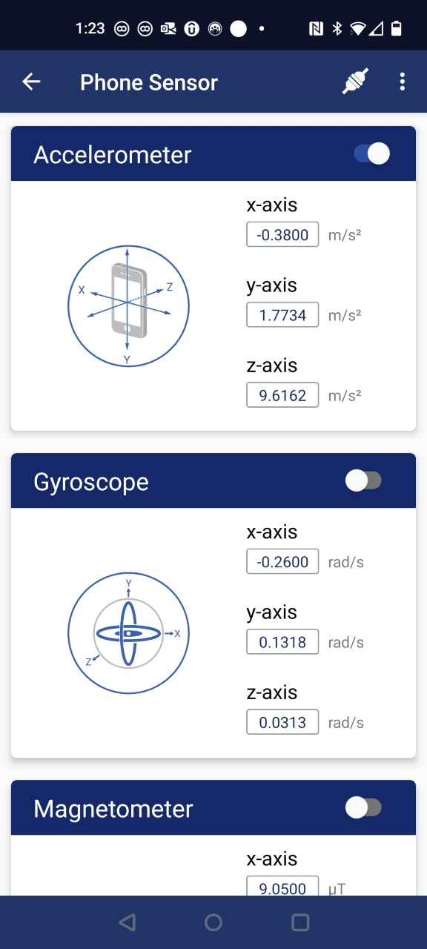
Phone Sensors
A lot of neat things your phone can do. We’ll play with the accelerometer.
Download Accelerometer_LED.ino from GitHub.
Upload to the Arduino and open the Arduino serial monitor.
Open Dabble and select Phone Sensors.
Switch the Accelerometer on and rotate your phone.
Check the BAUD Rate on the serial monitor.
Try editing the code to light up the LEDS in order as you twist your phone

Slide 26
Arduino 10:
Arduino 10 will cover Hardware and Timer Interrupts
You’ll make a sound machine

